Slide 1

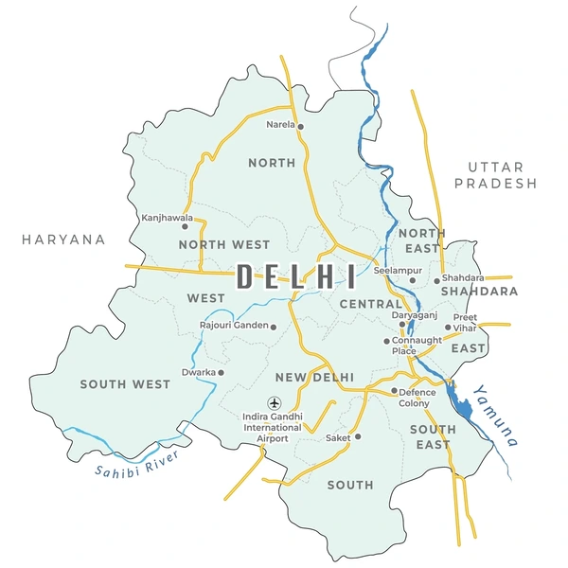
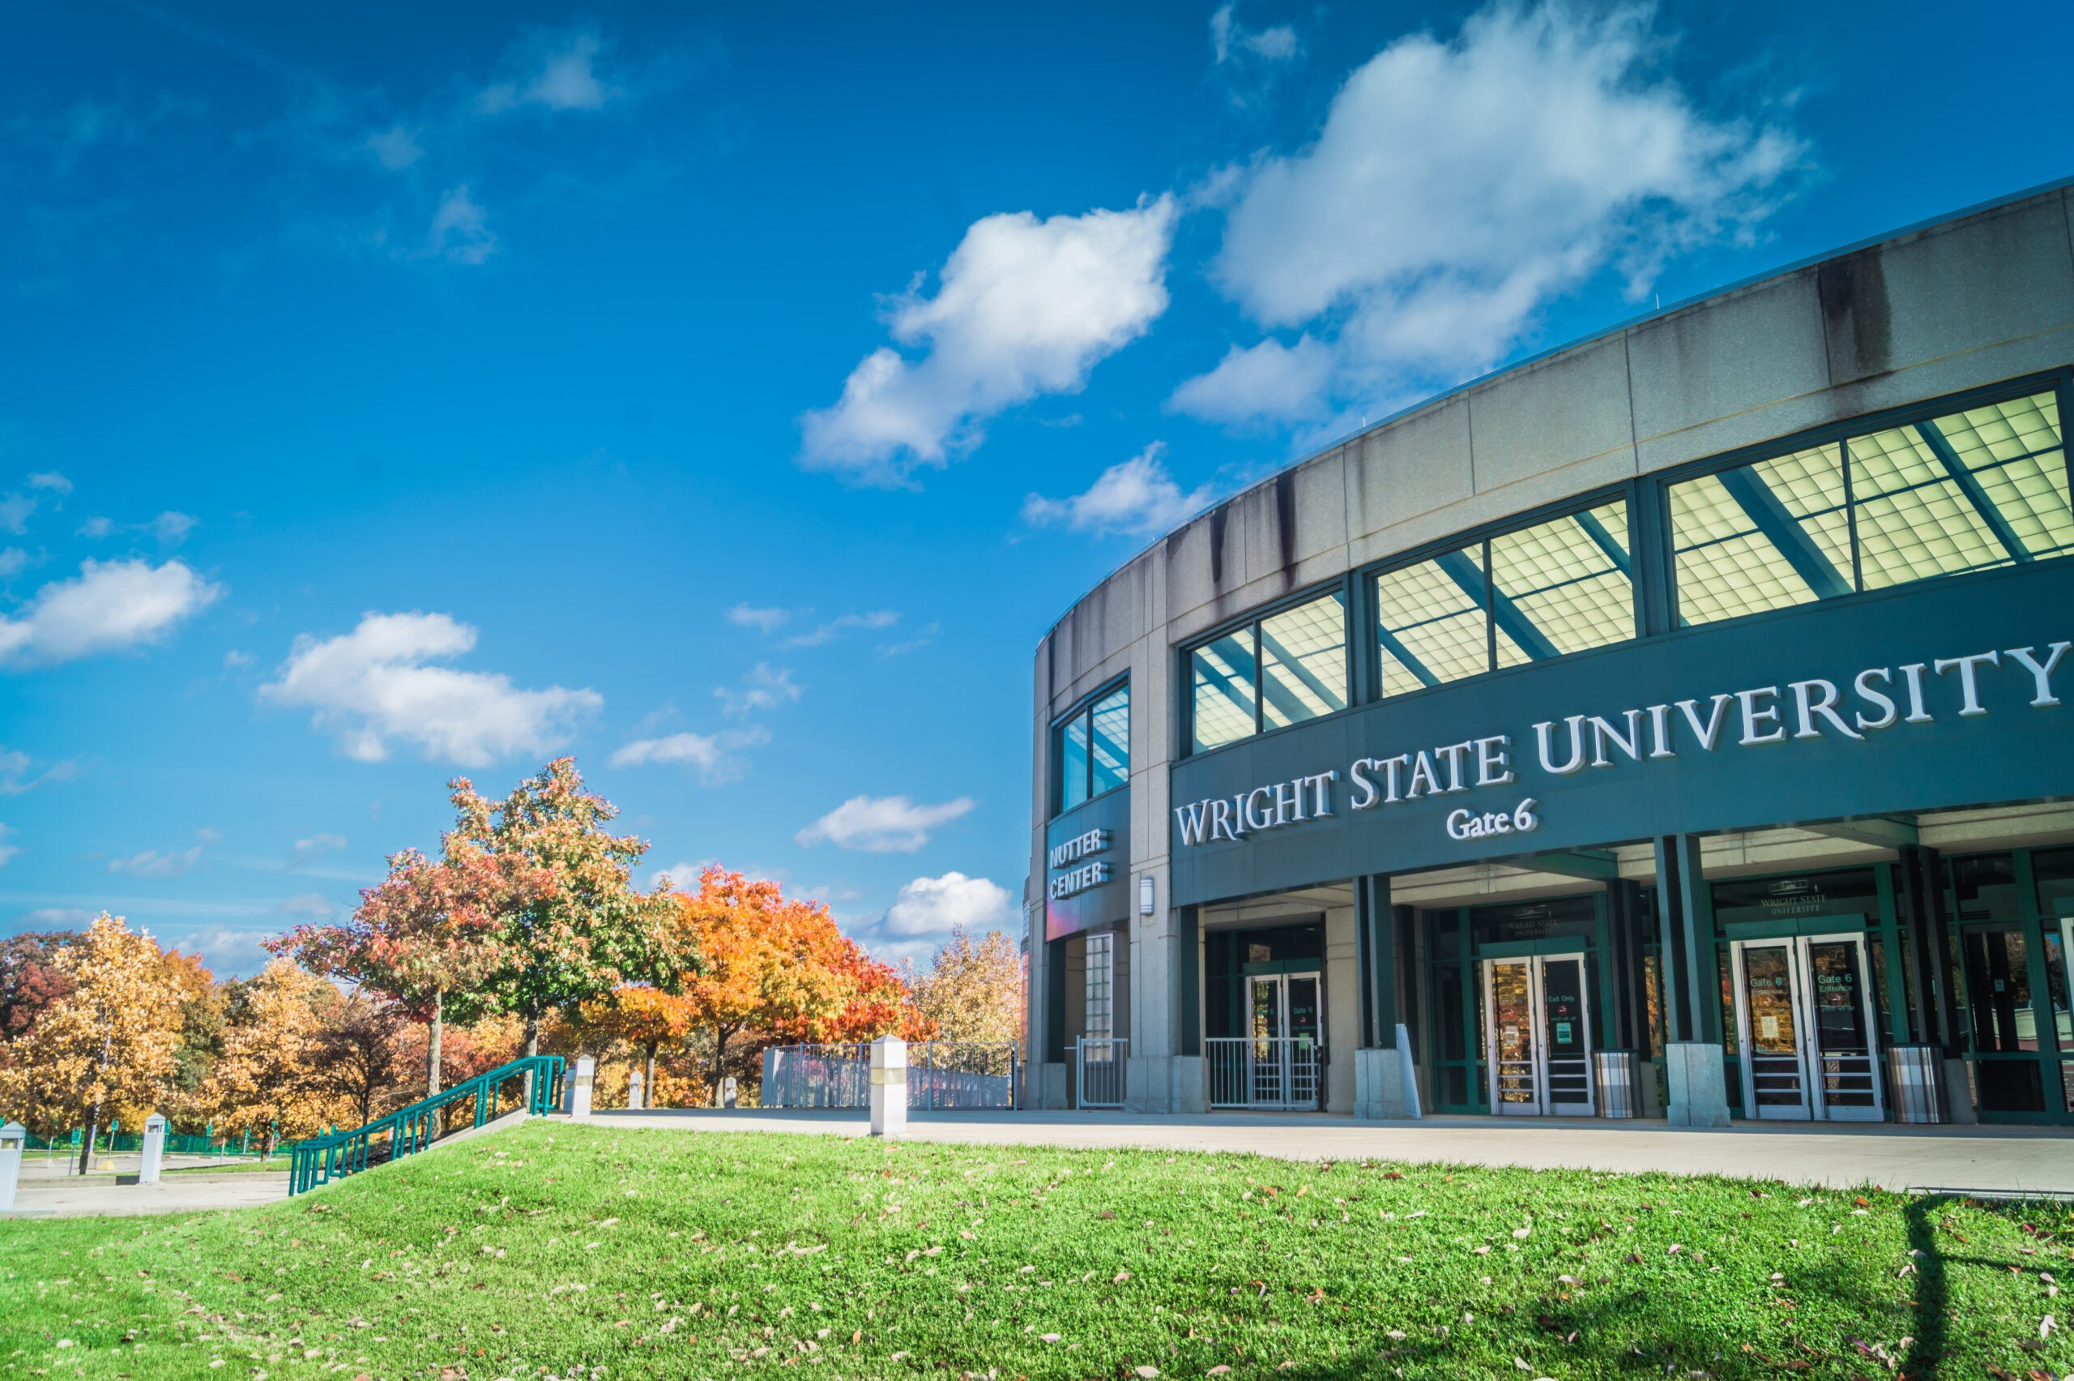
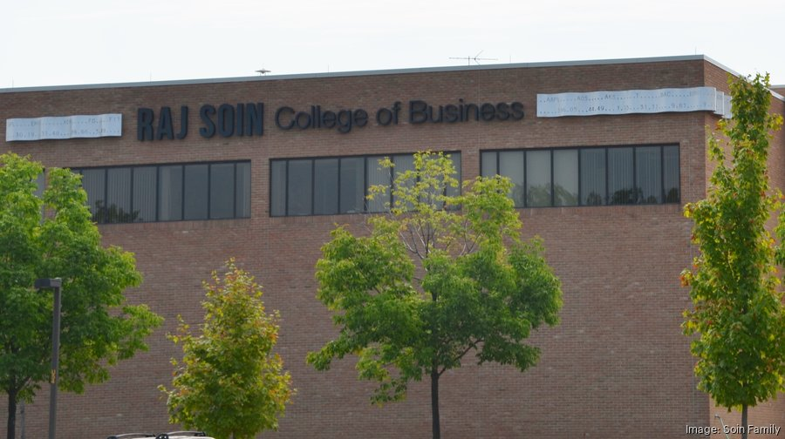
Digital Marketing
Post-Campaign Report

Slide 2
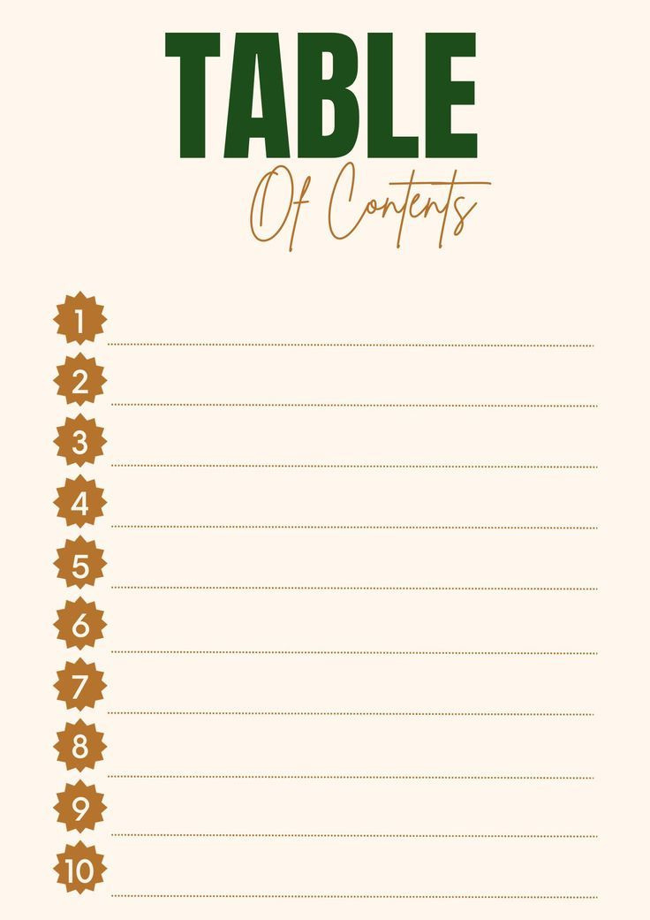





Campaign Overview
Key Result
Conclusion
Future Recommendation
Evolution of Campaign
Initial Approach/ What changed and Why
Justify The Investment
Learning Objective
Going Forward
Thank You

Slide 3


Campaign overview
The campaign's objective was to raise awareness of
Wright State University's Masters in Marketing Analytics
program in Delhi, India.
The campaign lasted for 8 weeks and the
total budget was $1500
Used Google AdWords (Search, Display, and Video).
Posted videos and posts on Facebook and Instagram.
Used Instagram for influencer marketing.
Our total expenditure was $921
Facebook and Instagram generated most impressions.
YouTube also gave us tremendous views.
Program Highlights: STEM courses, scholarships, flexible lasses, no GMAT/GRE required.

Slide 4

Key Results
Total Budget $921
Total Conversions from Google Ads 495
Total Impressions from Google Ads 94,487
Total clicks from Google Ads 8,751
Total Impressions from Facebook Ad
1,287,746
Total $628.11 spent on Google Ads with high CTR (11.8%) reflects effective ad copy and targeting. Google Display ad groups demonstrated excellent CPC efficiency ($0.05.)
Facebook and YouTube videos focused on promoting MSMAI through story telling using posts and videos which generated Total impressions of 1,287,746. Facebook had broader reach and higher impressions but less focused on direct conversions.
Google Ads were effective in driving direct engagement. Social media campaigns-built awareness and strengthened the program’s digital presence.
Promote MSMAI at Wright State University to prospective students in New Delhi, focusing on programs like STEM courses, scholarships, flexible classes.

Slide 5
Conclusion
To increase engagement and conversions, we used multiple strategies in our digital marketing campaign for the master's program in marketing analytics and insights in New Delhi.
The campaign's main objective of raising awareness and encouraging participation was accomplished. The successful outcome of the methods used can be seen by strong click-through rates, affordable CPCs, and high conversion rates across platforms.
The significance of storytelling is demonstrated by the impressive outcomes of video material.
Started by using platforms like Facebook and Google AdWords to specifically target particular demographics and keywords.
Used a variety of content types, such as posts and videos, to encourage interaction and offer insightful information.
Encountered difficulties such mid-week campaign performance issues, A/B testing issues, keyword failures, and achieving positive video impressions.

Slide 6
Future Recommendation
Track/Modify
Reallocate your budget by spending more on keywords or ad groups that are performing well and less on those that aren’t. Introduce re-marketing campaigns to re-engage high potential users.
Dayparting
Plan your advertisements to run on the days or hours when your target audience is most engaged.
Focus on cost-per-conversion
Give top priority to advertising expenditures for campaigns that yield the highest return on investment (ROI).
Optimize your keywords
To find irrelevant and high-performing keywords, use search term reports. Use negative keywords to weed out traffic that isn't qualified.
Segmenting the audience
To further customize your adverts, concentrate on particular audience demographics, interests, or remarketing lists.
Geo-targeting
To give priority to areas or places with a better conversion rate, change the geographic parameters.
A/B Testing
A/B testing to refine ad Copy and creative assests.

Slide 7


EVOLUTION
OF
CAMPAIGN
Initial Approach
What Changed and Why
Overall Campaign perfomance

Slide 8
Initial Approach
Our campaign aimed to promote the MSMAI program using platforms like Facebook, Instagram, YouTube, Google Search, and Google Display to maximize reach and engagement.
Campaign Goals: Increase awareness of MSMAI in New Delhi, focusing on STEM benefits, scholarships, flexibility and drive website traffic and generate enrollment inquiries.
Target Audience: Individuals aged 18–35 in New Delhi, including students and working professionals interested in advanced marketing analytics education.
Platform Selection: Google Ads to capture intent-based audiences searching for STEM courses. Facebook and Instagram to reach a broad audience through engaging visuals.
Keyword Strategy: To Focus on terms like “Wright State University,” “STEM degree in the USA,” and “affordable marketing programs.”
Budget Planning: Allocated $1,500 strategically, adjusting based on platform performance and ROI.

Slide 9
What Changed and Why ????
As per our Planned Strategy we also added Google Video Campaign. Videos drove deeper engagement. Reposting high-performing content(Video 1) proved effective.
As planned targeted demographics were successful in generating engagement levels and cost-effectiveness.
Key words as assumed to be an integral part turned out to be the Negative keyword. Ex- Wright State University and International Student Scholarships
Based on the Research and diving deeper to LinkedIn, we decided to drop the plan and allocate the budget to the performing Ads. We create an additional Display Ad Group with the planned budget of LinkedIn.
After allocating the whole money to Campaign Performance, we spent $921. This included holding back the Influencer Campaign to Action and re-marketing a few videos and ad posts.
Google Ads were effective in driving direct engagement. Social media Campaigns built awareness and strengthened the programs digital presence.

Slide 10

GOOGLE ADWORD
STRATERGY IMPLEMENTATION
Emphasized Search, Display, and Video campaigns.
Executed strategy, testing all campaigns.
Prioritized better-performing campaigns.
Display campaign outperformed search in authentic conversions, clicks, and impressions.

Slide 11
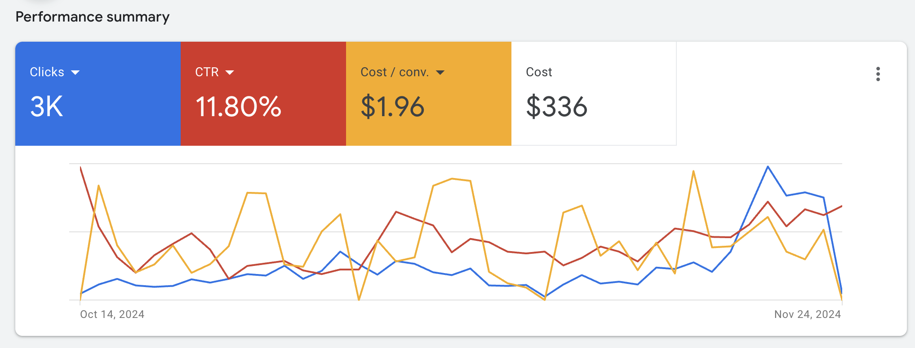
The initial objective was to focus on and implement Google AdWords search, display, and video advertising.
We implemented the strategy and developed. The strategy involved testing all campaigns and prioritizing the best-performing ones.
Our display campaign outperformed the search effort in terms of real conversions, clicks, and impressions.
GOOGLE
SEARCH

Slide 12
Impression 25,405K
Clicks 2.997K
Average CPC $0.11
Click-Through Rate (CTR) 11.80%
Conversion 172.00
Cost $336.44
According to the pre-campaign report initially our budget for the Search Campaign was $375 but we changed our budget allocation based on our Google ad performance during the initial weeks and ended to $336. Our final campaign reached 25k impressions, having 2.99k clicks with an average cost per click of 0.11%. With a click-through rate of 11.80% and a conversion rate of 172.
Our campaign has outperformed with a higher CTR and conversation rate.
For the first week, we allocated a budget of $3.88 proceeding to Week 2-4 ($4.32 to $7.35) and week 5-6 ($9.24 to $22.03) and gradually increased to $29.01 for rest of the week.
AD GROUP 1

Slide 13
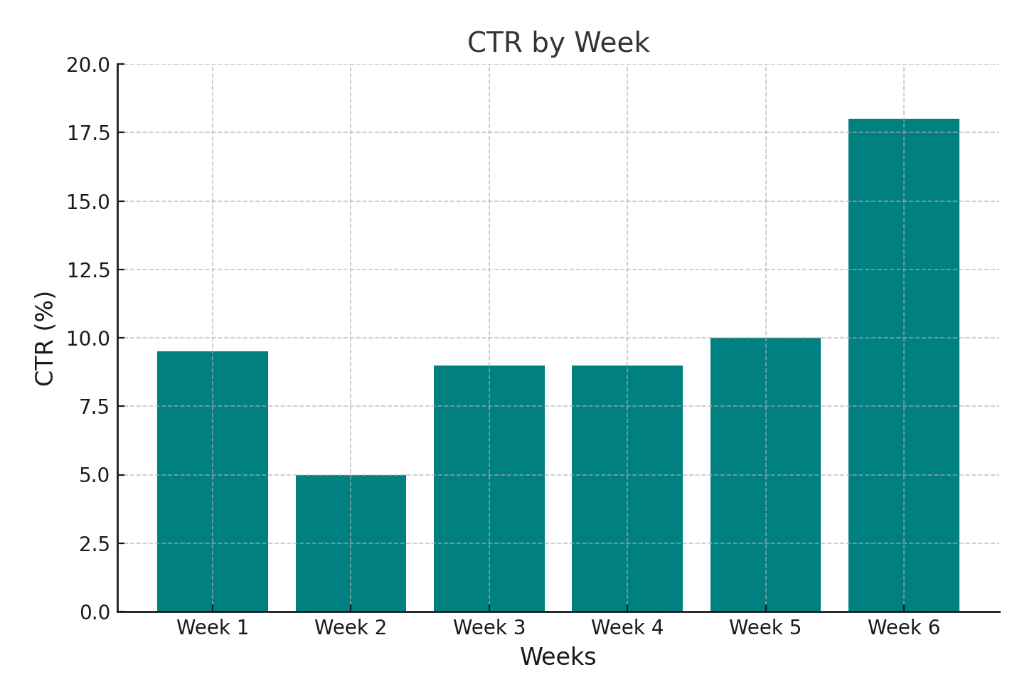
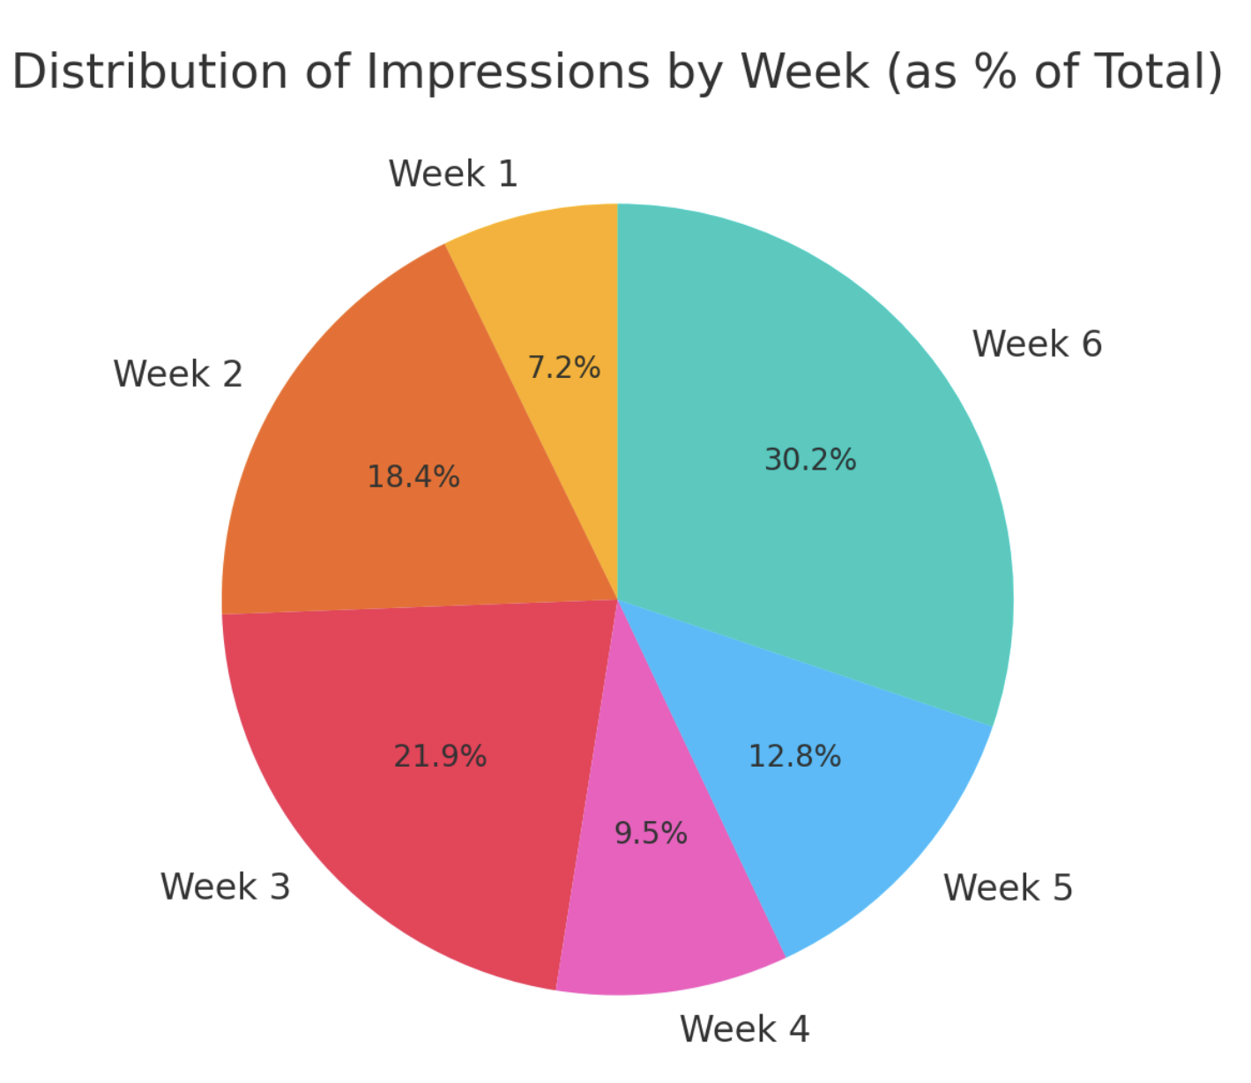
Click-Through Rates
Impressions
Week 1 showed a strong CTR of 9.5%, indicating effective targeting and ad relevance. Week 2 saw a drop to 5.0%, but Weeks 3 and 4 saw a steady recovery with adjustments with improved ad copy and keyword optimization. Week 6 saw a sharp increase to 18.0%, indicating highly optimized campaign elements with more relevant keywords and better-Quality Scores.
The chart shows the weekly distribution of impressions for the campaign. Week 1 (7.2%) had the least, indicating a gradual ramp-up in performance over time, peaking in the later weeks. The second-highest share of impressions occurred in Week 3, showing strong performance. Week 6 (30.2%) had the highest visibility indicating increased ad spend, better targeting, or improved ad performance.

Slide 14
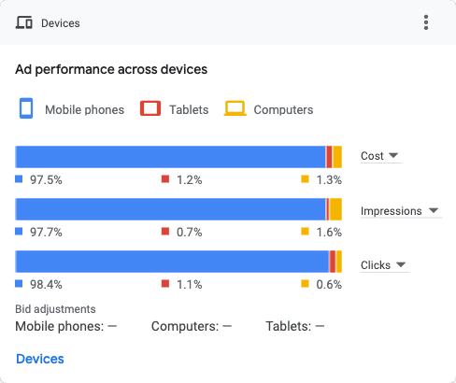
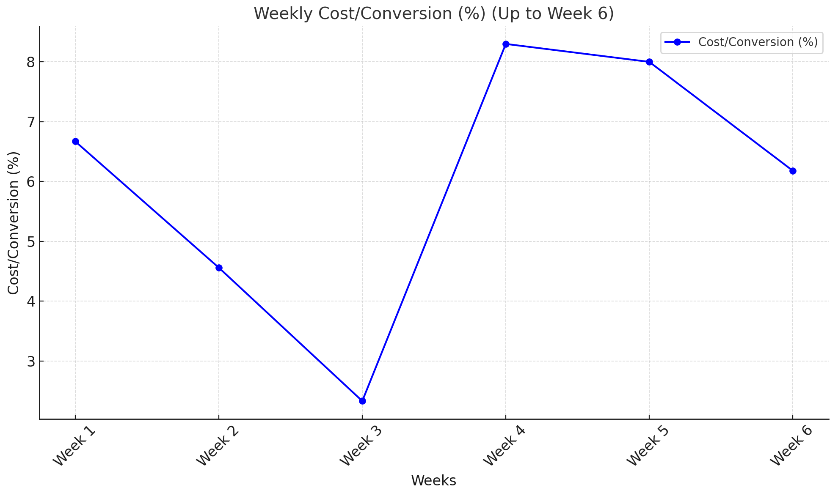
The weekly Cost/Conversion rates vary significantly, with Week 4 showing the best success at 8.30%. Weeks 2 and 3 indicate a downward trend, whereas Weeks 4 and 5 rebound significantly. Overall, the later weeks (Weeks 4-6) outperformed Weeks 1-3.
During the campaign, most people preferred to browse on mobile devices rather than tablets or laptops (fig.).
Mobile devices generated the majority of clicks and impressions.

Slide 15
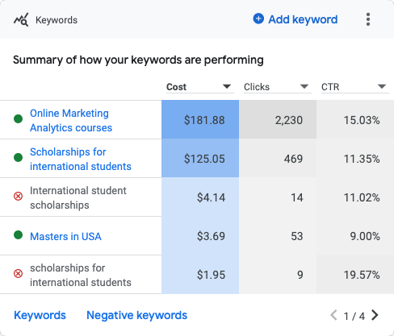
Keywords Performance
Keywords such as "Online Marketing Analytics courses" and "Scholarships for international students" generate majority of clicks but at higher costs (e.g., "scholarships for international students")show strong CTR, indicating optimization chances.

Slide 16
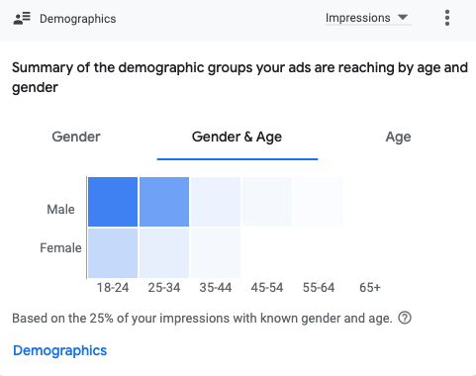
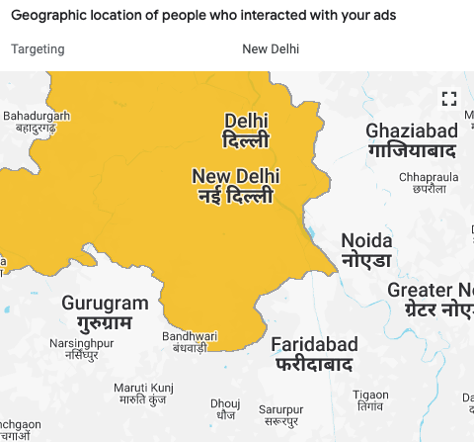
Geographic Target
The ads have primarily engaged users in the New Delhi region, including nearby areas such as Gurugram, Noida, and Faridabad.
The ads reached majority of users aged 18-34, Minimal engagement is observed among older age groups (35+), indicating that the target audience skews younger.

Slide 17
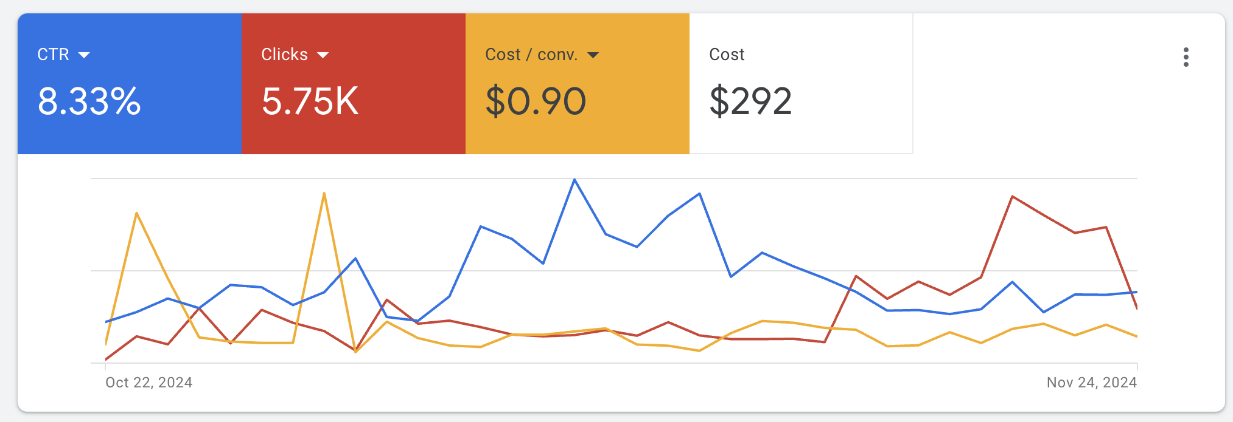
The Campaign started on Oct 22,2024 and ended on Nov 25, 2024.
The campaign is aimed to showcase a strong return on investment while simultaneously highlighting cost.
Our Display Campaign outperformed the search effort in terms of clicks, and impressions.
GOOGLE
DISPLAY

Slide 18
According to the pre-campaign report initially our budget for the Display Campaign was $375 but we changed our budget allocation based on our Google ad performance during the initial weeks and ended to $291. Our final campaign reached 69.1k impressions, having 5.75k clicks with an average cost per click of 0.05%. With a click-through rate of 8.33% and a conversion rate of 292.
Our campaign has outperformed with a higher impressions and Click Through Rates.
For the first week, we allocated a budget of $5.02 proceeding to Week ( 2-4) $10.02 and gradually increased to $22.01 for rest of the campaign.
Impressions 69.1k
Clicks
5.75k
Click Through Rates (CTR) 8.33k
Average CPC 0.05
Conversions 323
Cost
292

Slide 19
Impression 43K
Clicks 3.26K
Average CPC $0.05
Click-Through Rate (CTR) 7.58%
Conversion 174
Cost $163
Impression 26.1K
Clicks 2.5K
Average CPC $0.05
Click-Through Rate (CTR) 9.56%
Conversion 149
Cost $129
AD Group 1
AD Group 2
Ad Group 1 achieved higher impressions, clicks, and conversions but with a slightly lower CTR compared to Ad Group 2.
Ad Group 2 delivered a better CTR, indicating more efficient engagement, despite fewer overall impressions and clicks. Both groups have an identical average CPC.
We spent for about $129.10 for Ad Group 1 and $162.57 for Ad Group 2 and achieved a total of 69.1K Impressions.

Slide 20
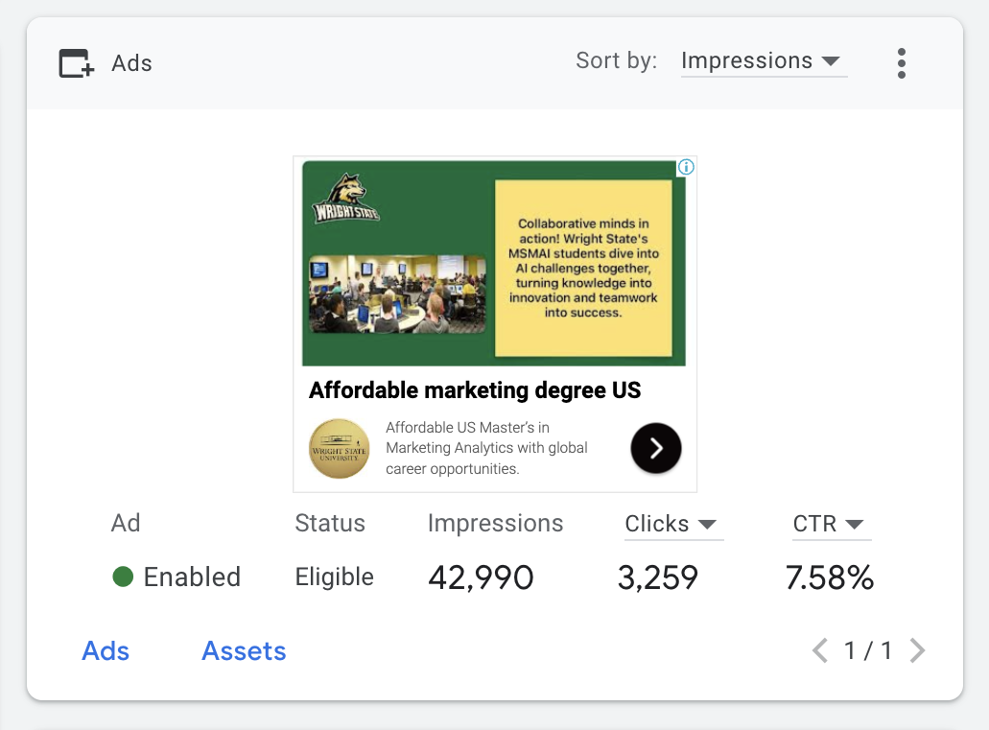
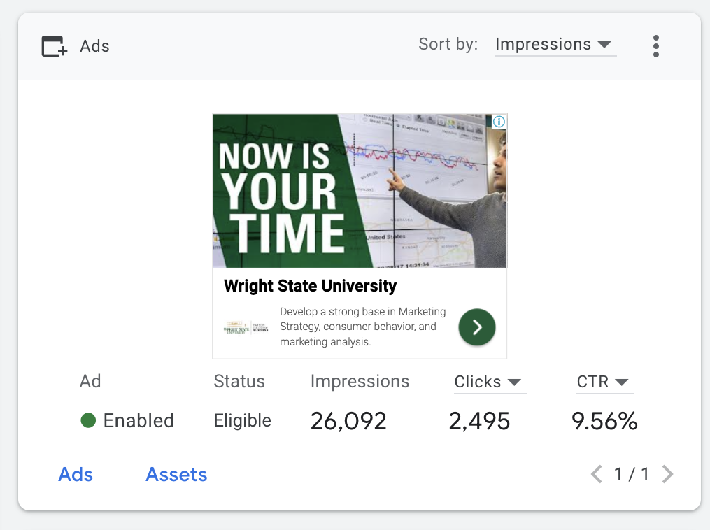
Ad Group1 and 2 Performance
Ad Group 1- Cost/Conv $0.93
Ad Group 2- Cost/Conv $0.87
Ad Group 1- Conv.Rate 5.34%
Ad Group 2- Conv.Rate 5.97%
Ad Group 1 relatively Performed well in all terms including an efficient Cost/Conv Rate of 25.00%

Slide 21
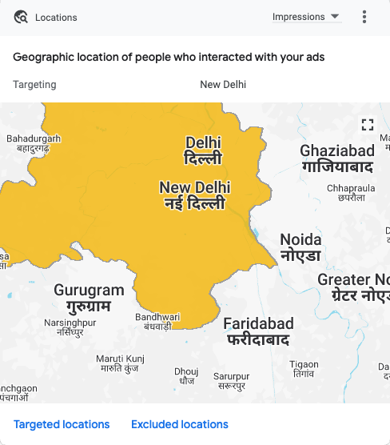
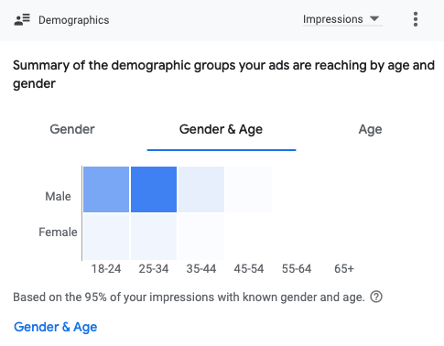
Our search and display campaign results show that men aged 25-34 are the most interested in the ad.
These individuals may be parents looking for classes for their children or those who truly have an interest in the programs.
These ads have also had primarily engaged users in the New Delhi region, including nearby areas such as Gurugram, Noida, and Faridabad.

Slide 22
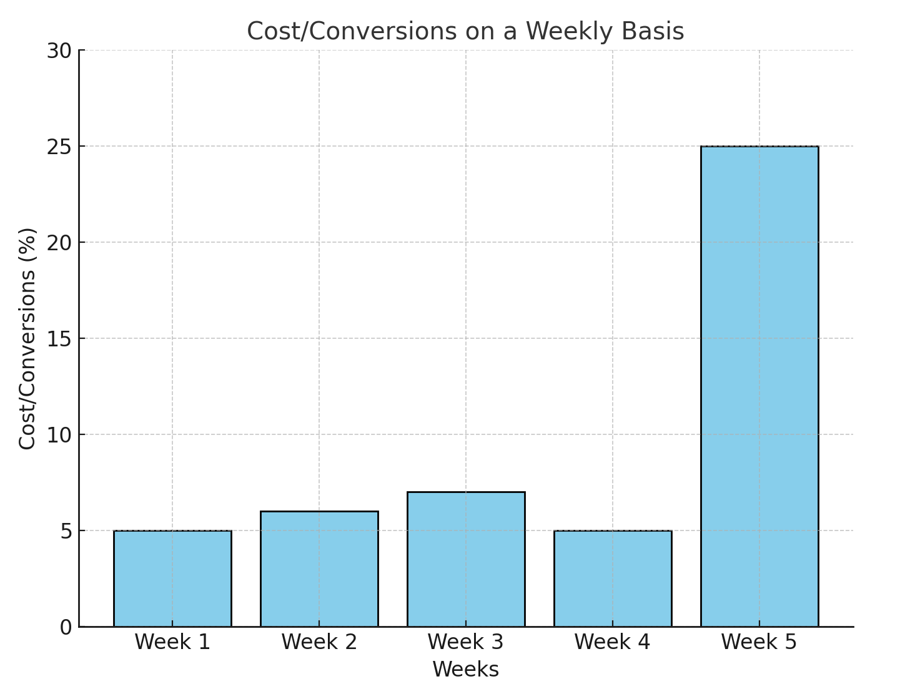
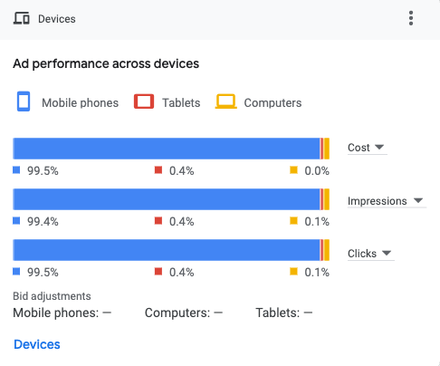
There is a relatively steady performance in Weeks 1 through 5, with percentages ranging between 5.21% and 7.60%.In Week 5, there is a significant spike, with the cost/conversions jumping to 25.00%.
The Spike in Week 5 has happened due to an event change to the Ad Group where we uploaded a Video for an effective campaign result.
For the Display Campaign too , majority of users preferred Mobile Phones than the Tablets and Computers.
Mobile Phones seemed quite convenient for users to watch ads, videos and reels

Slide 23
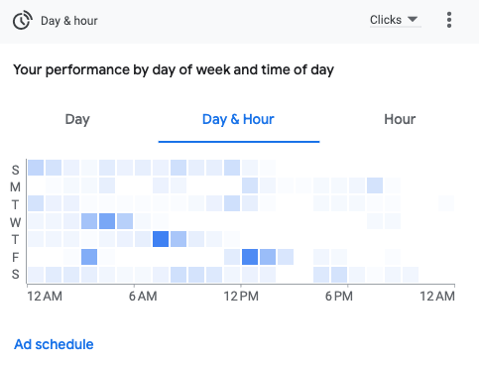
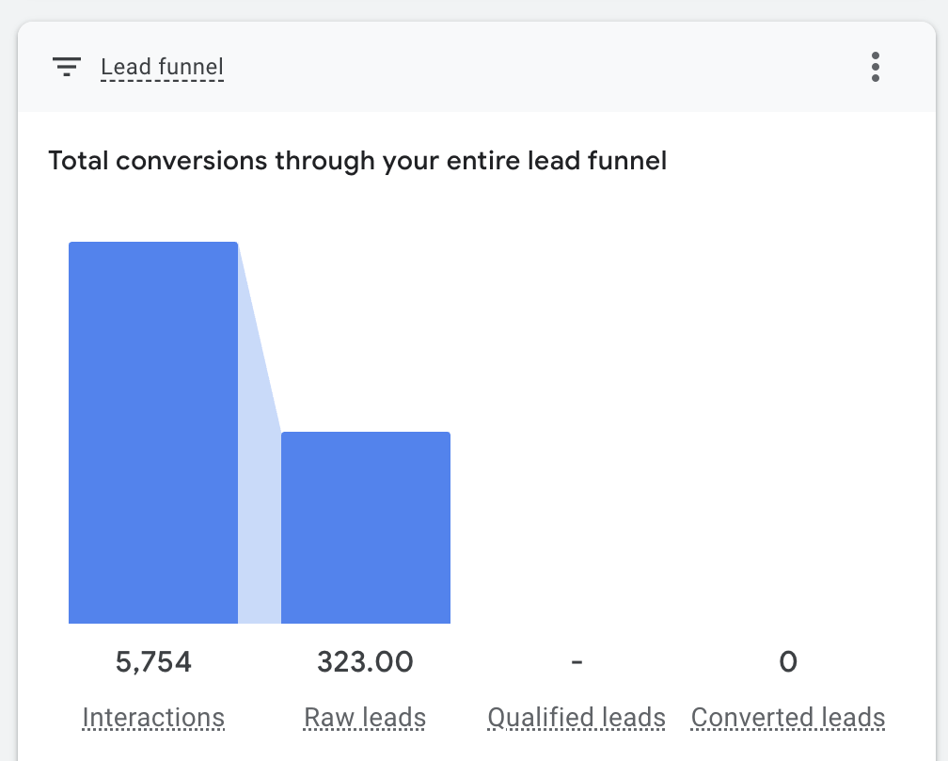
Observations and Analysis
Performance Patterns:
• Darker spots indicate increased activity.
• Peak activity occurs throughout lunchtime and early morning.
Day-specific insights:
• Wednesdays and Thursdays have higher performance.
• Weekend performance tends to be lower or scattered.
Time-specific trends:
• Peak activity occurs between 6 AM and 12 PM.
• Evening hours exhibit low activity.
There are 5,754 interactions, showing high initial interest. Only 323 raw leads were created, indicating a substantial reduction of potential clients as a result of lead exchanges.

Slide 24
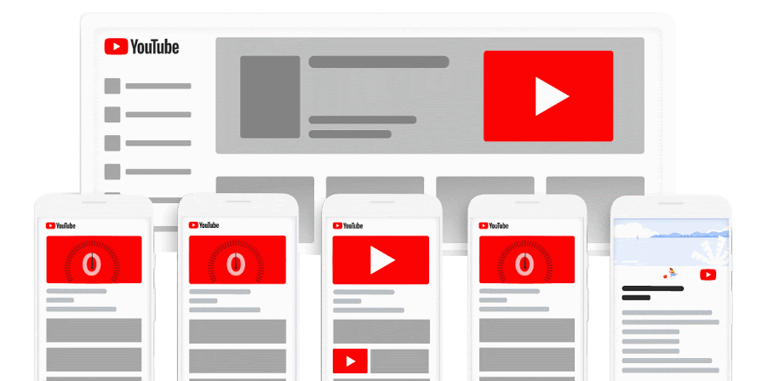
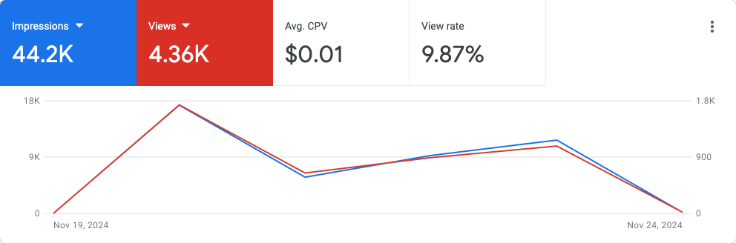
Google Video
The campaign started on Nov 14,2024 and ended on Nov 24,2024.
This was planned for a shot duration and hence had impressive results of 44k Impressions and 4.36K views.
We spent $8.05/Per day for the Campaign.
Creating a Google Video Ad Campaign is an effective strategy for businesses to engage audiences visually and emotionally.

Slide 25
Google Video Campaign Stats
Impressions 44.2K
Views 4.36K
Clicks 532
Cost $41.59
View Rate 9.87%
Average CPC $0.01
Cost/Conv $0.99

Slide 26
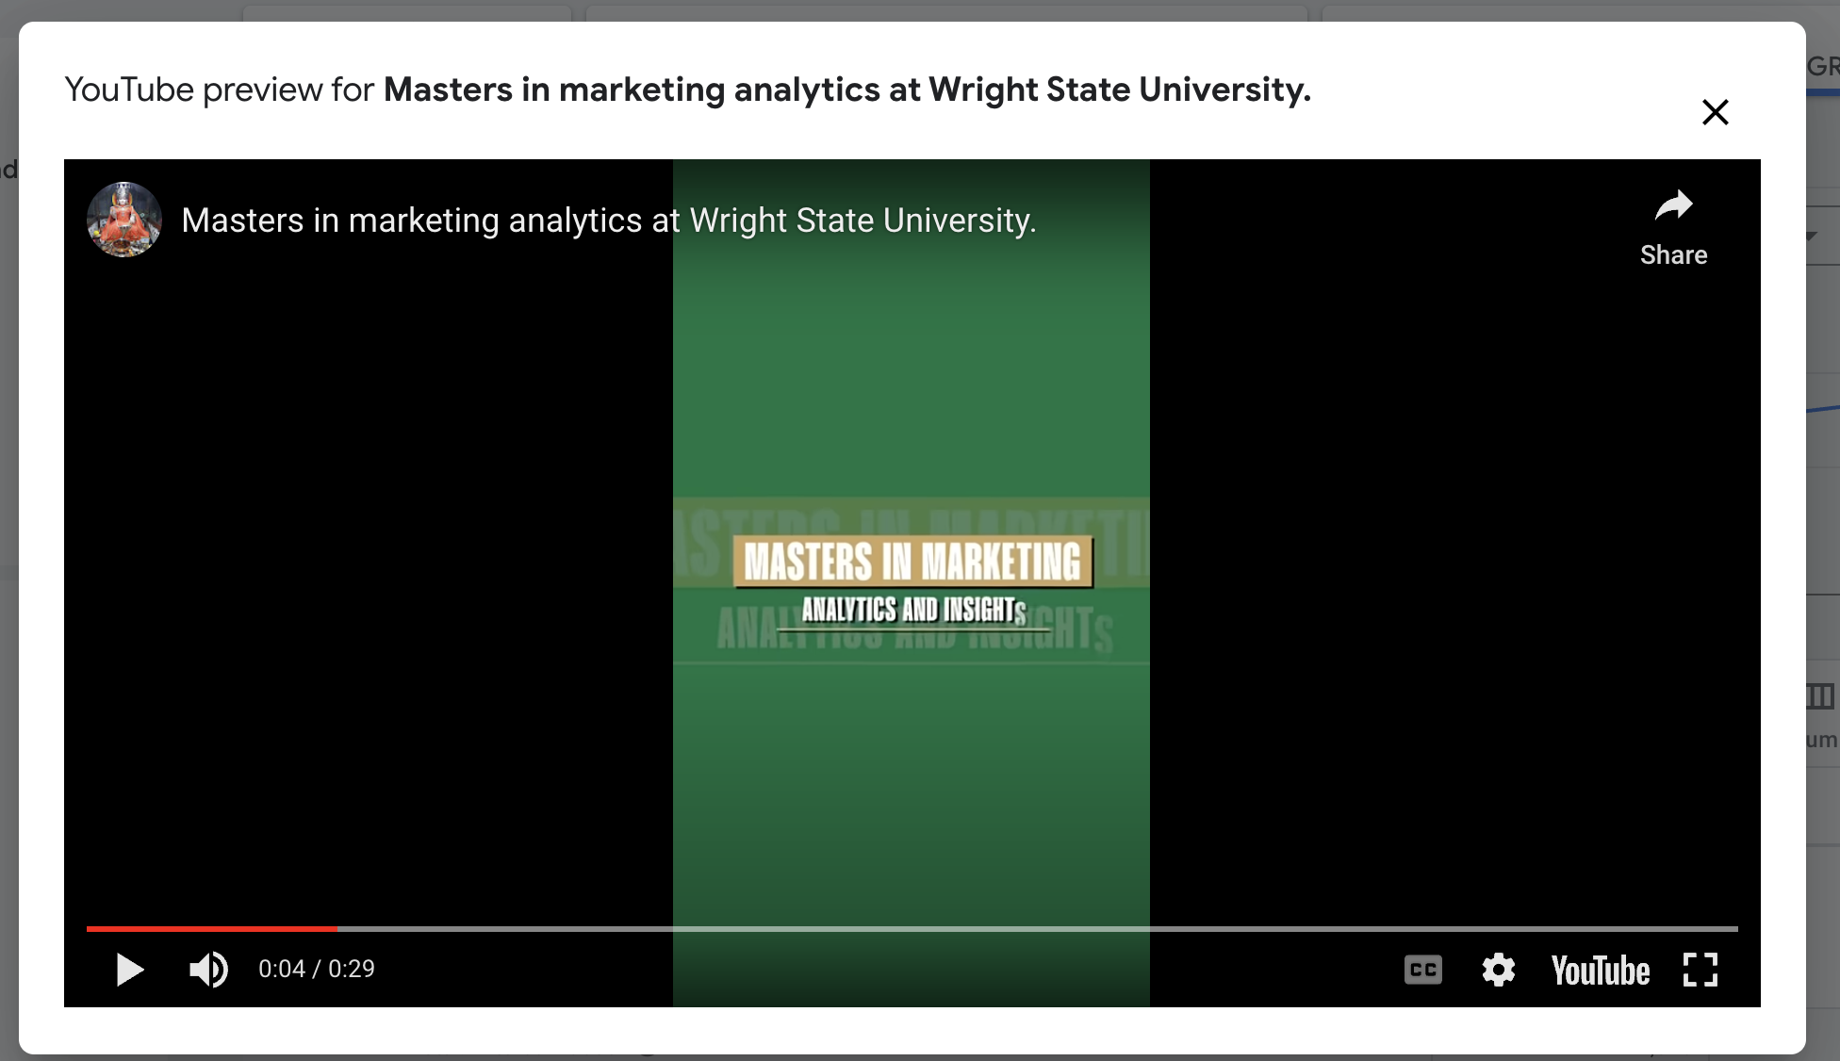
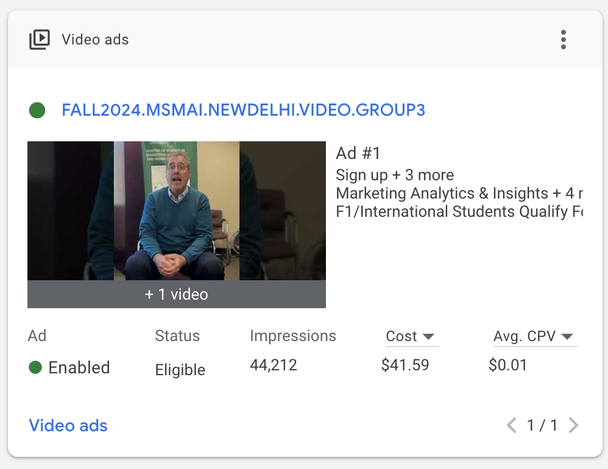
Google Video Ad Group
Conv. Rate- 0.36%
Conversions 42.00
Impressions- 9846
Views – 969
Cost-$9.62

Slide 27
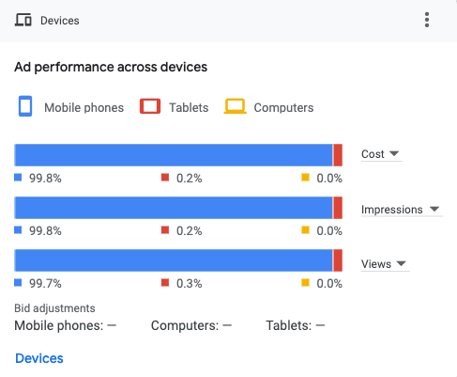

Ad Performance
Across devices, most watched videos are on Mobile phones. Sounds like a Go To Device for Convenience and Interest.

Slide 28
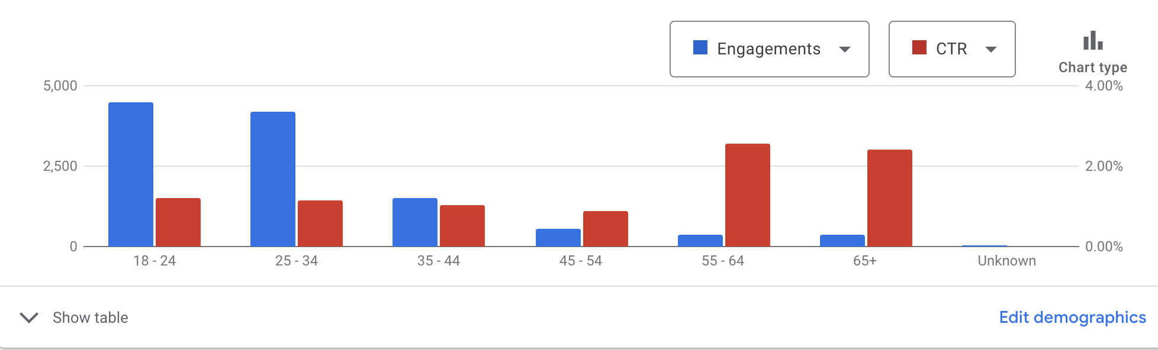
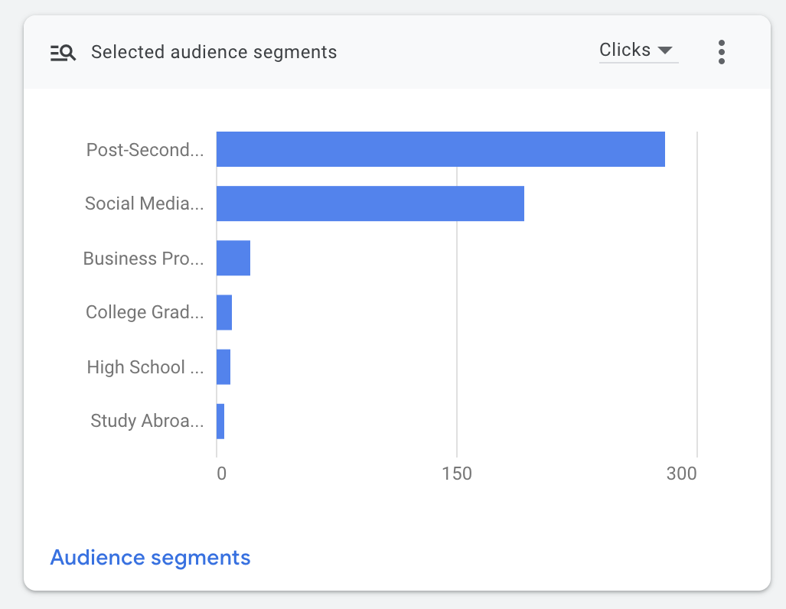
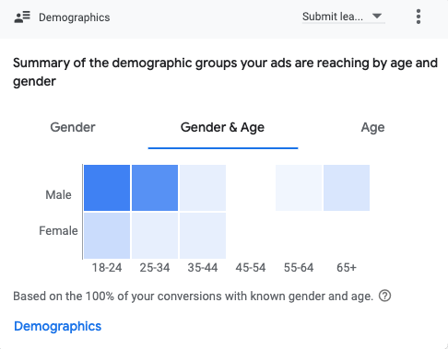
Demographics as per Gender and Age
Within the audience segment of our Video campaign, we observed that individuals searching for Post Secondary Education were also engaging with our course advertisements.
Most Engagements are from 18-25 and clicks from above the age group of 64. males seem to have greater interest than Females.

Slide 29


SOCIAL MEDIA
We decided to promote MSMAI
through social media channels like
Facebook and Instagram in
New Delhi, India
because Delhi is the hub of
Social media influencers
and have high percentage
of people using Facebook and Instagram.

Slide 30

Social Media Overall Performance
We used these platforms to convey a story through our campaign, which included two posts and two videos about our school, program, and recent student accomplishments. The results were excellent.
Reach 394,839
Impressions 1,287,746
Results 21,484
Clicks 30,360
CPC $0.27

Slide 31


Budget and Post 1
The first post we made on October 13, 2024, used $30 of the $260 we allocated for our social media campaign on Facebook and Instagram for the first week, inspiring those who wished to pursue marketing careers.
Reach | Impression | Results | Clicks | CPC
42119 | 213972 | 5328 | 5328 | $0.01

Slide 32

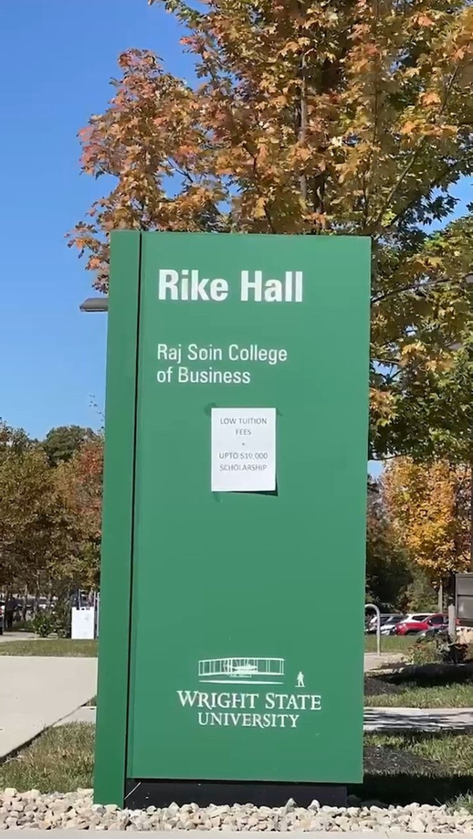

Video Post 1
Reach | Impressions | Results | Clicks | CPC
71826 | 80489 | 3389 | 7093 | $0.01
We recorded a video and shared it for a week on Instagram and Facebook on 1—22-2024. We set aside $30 for the budget. The advantages of studying MSMAI at Wright State University were demonstrated in the video, including stem designation, scholarships up to $10,000, flexible class schedules, and the absence of GMAT or GRE requirements.
We decide to run video for another week on 11.17-2024
and the we spend $50 for second week.

Slide 33

We increased the budget from $30 to $75 for our third post on November 8, 2024, and we chose to run it for three weeks, while encouraging people to apply in Wright State.
We increase the budget because our prior posts have yielded positive results. Increasing the budget can result in more favorable outcomes, as we experienced.
Page Engagement | Clicks | CPC
17767 | 17767 | $0.01

Slide 34

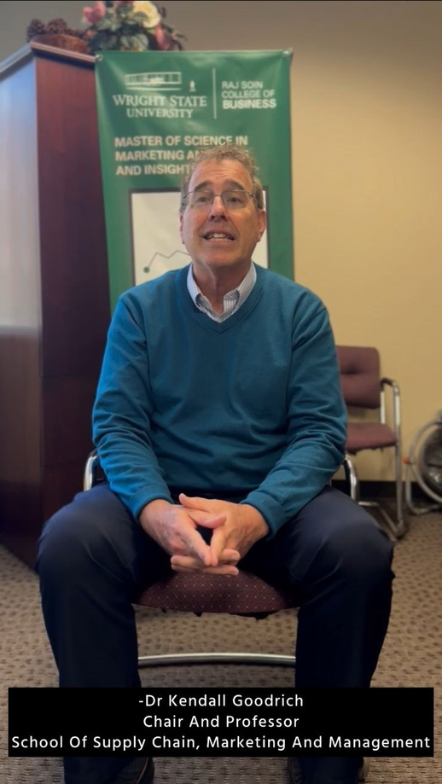
Video Post 2
We shot another video that covered our professor Kendall Goodrich explaining about the course and its benefits followed by feedback of current success student and the founder of Analytics club at Wright State. It was posted on 11/19/2024.
The budget set for the
video was $75 for 1 week.
Reach | Impression | Results | Clicks | CPC
280894 | 993285 | 17767 | 172 | $0.45

Slide 35


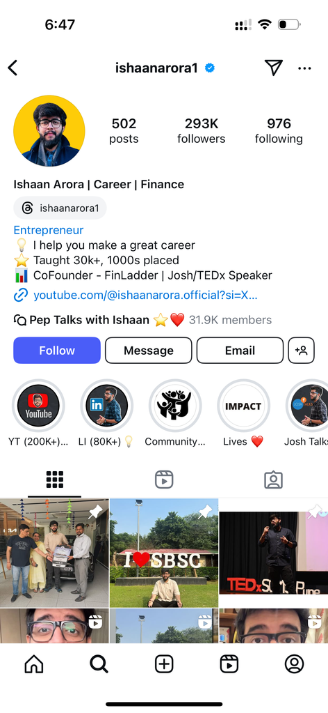

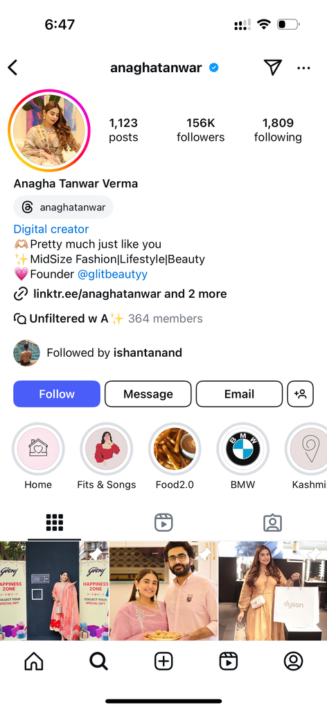

INFLUENCER MARKETING
ISHAAN ARORA
ANAGHA TANWAR
VERMA
Initially we decided to
keep 150$
budget for influencer
marketing but
as we continued
through campaign,
we had enough budget left
so we
decided to approach
an influencer
with more followers.
Instagram username:
ishaanarora1
Instagram username:
anagha tanwar
We approached Ishan
for influencer
marketing
because all his
content
is related to education
field. He quoted us 330$
We approached
Anagha
for influencer marketing.
She had a very good
fan following in
Delhi region.
She quoted us 250$.

Slide 36
Justify The Investment
Campaign Reach and Engagement: Google AdWords campaigns (Search, Display, and Video) delivered substantial results:
Search Campaign: 25k impressions, 2.99k clicks, 11.8% CTR, and 172 conversions.
Display Campaign: 69.1k impressions, 5.75k clicks, 8.33% CTR, and 292 conversions.
Video Campaign: 9.8k impressions, 969 views, and 42 conversions.
Social media posts and videos on Facebook and Instagram effectively captured attention, generating significant impressions and engagements.
Cost Efficiency: The campaign achieved a competitive average CPC (e.g., $0.05 for Display Ads) and strong conversion rates across platforms. High cost-efficiency is evident, especially in the Display Campaign’s cost/conversion rates ($0.93–$0.87).
Targeted Audience Impact: Ads successfully engaged the primary target demographic (ages 18–34) in the Delhi region.
Alignment with Objectives: The campaign fulfilled its main goal of increasing awareness about the MSMAI program, as evidenced by high click-through and conversion rates. Strong storytelling through video content demonstrated the program's value and captured the audience’s interest.
Scalability and Learning: The campaign allowed for testing different ad formats and adjusting strategies in real-time, providing insights for future campaigns.
Overall, the $921 investment produced strong impressions, high engagement, and measurable conversions, supporting the program’s visibility in a key international market.

Slide 37
1. Strategic Budget Allocation:
Effective budget management is key. The dynamic reallocation (e.g., adjusting budgets for Google Search and Display campaigns based on performance) highlights the importance of flexibility and real-time optimization.
2. Performance Metrics and Analysis:
Understanding metrics such as impressions, clicks, CTR, CPC, and conversion rates is crucial for evaluating campaign success. For instance:
High CTR (11.8%) and strong conversions in the Search Campaign.
Cost-effectiveness in the Display Campaign with low CPC ($0.05).
Analyzing these metrics helps refine strategies and justify ROI.
3. Audience Targeting and Segmentation:
The importance of precise targeting is evident. As per this campaign we learned demographics with age group 18–34, were the most engaged. Keywords like “STEM”, "scholarships" and "online courses" are relevant.
4. Content Strategy:
Storytelling is powerful in digital marketing. Videos showcasing program benefits and student achievements drove higher engagement. A mix of content types (posts, videos, reels) provided varied touchpoints for the audience.
5. Multi-Platform Approach:
Using diverse channels (Google Ads, Facebook, Instagram) demonstrates the need to meet audiences where they are. Leveraging platform strengths, like influencer marketing on Instagram, can boost credibility and reach.
6. Experimentation and Adaptation:
A/B testing and iterative improvements (e.g., changing ad copies, optimizing keywords) are essential. Adjusting based on mid-campaign performance issues, like video engagement or keyword failures, shows the need for adaptability.
7. Device Preference Insights:
The majority of clicks and impressions came from mobile devices. This underlines the need for mobile-first strategies in digital marketing.
8. Campaign Lifecycles and Optimization:
Campaigns evolve over time. Monitoring weekly trends and focusing on peak weeks (like Week 6 in Search Campaign) ensures resources are allocated effectively during high-impact periods.
9. Importance of Storytelling and Visuals:
Video campaigns yielded strong engagement by emotionally connecting with viewers and visually presenting program benefits.
These learnings underscore how data-driven decision-making, adaptability, and a customer-centric approach are integral to successful digital marketing.
What Did Your Group Learn?

Slide 38

Going Forward
Increase
Increase focus on video content With low cost-per-result and high engagement, allocate a larger budget to videos.
Invest in
Invest in retargeting campaigns: Use data from this campaign to reach users who engaged but didn’t convert.
Create
Create Multi Ad Groups for Campaigns- we have focused ad groups on display and could not start with Video campaign in the start stage.
Highlight
Highlight success stories, testimonials, and reviews to build trust and credibility post or videos.
Frequent
Frequent Evaluation of Performance- Weekly analysis to spot trends and take appropriate action, periodically examine campaign data like CTR, ROI, and conversion rate.
Eliminate
Eliminate poor performers: Advertisements, keywords, or audiences that continuously perform poorly should be paused or modified.

Slide 39


